Slide 1
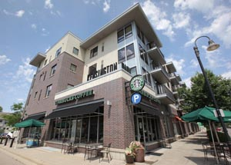
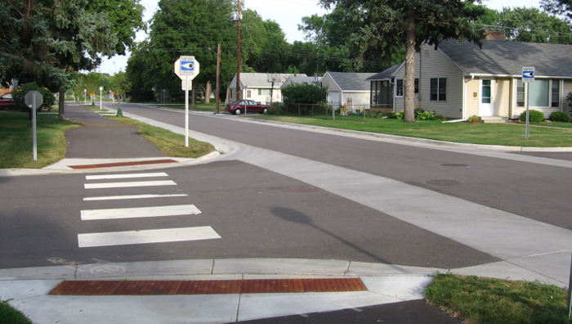
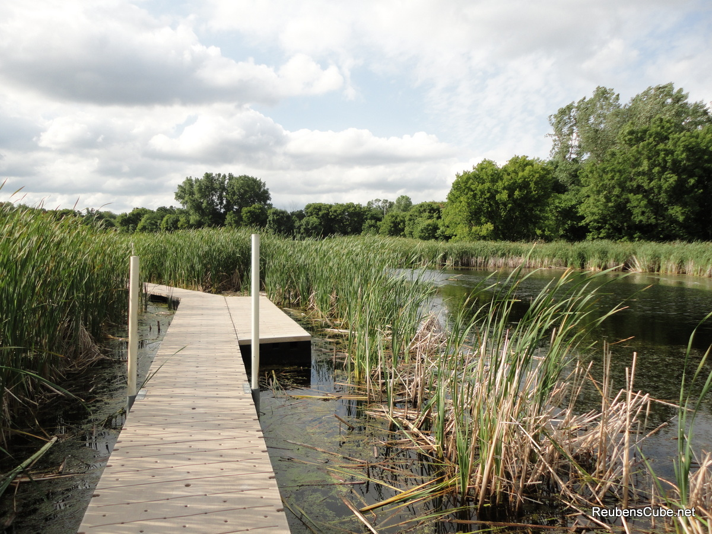
City of Richfield Comprehensive Plan Update
Advisory Committee Meeting Monday, June 12, 2017

Slide 2
Welcome
Tonight’s Talking Points
Introductions (5 minutes)
Recap to Comprehensive Planning (5 minutes)
Public Engagement Findings (15 minutes)
Group Discussion (60 minutes)
Next Steps (5 minutes)

Slide 3
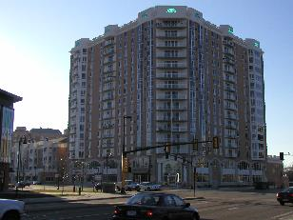
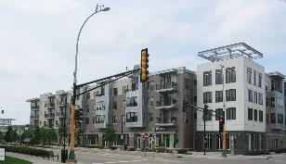
Comprehensive planning 101
Comprehensive Plans Provide:
Vision Statements and Goals
Policy Direction
Guides Growth
Twenty Year Time Horizon
Prepares for Implementation

Slide 4
Comprehensive planning 101
Minnesota State Statue
Seven County Metro Cities and Counties are required to update their plans every 10 years.
Facilitated by the Metropolitan Council
Updates need to align with regional polices (2040 Thrive MSP)

Slide 5
Plan Element Requirements

Slide 6
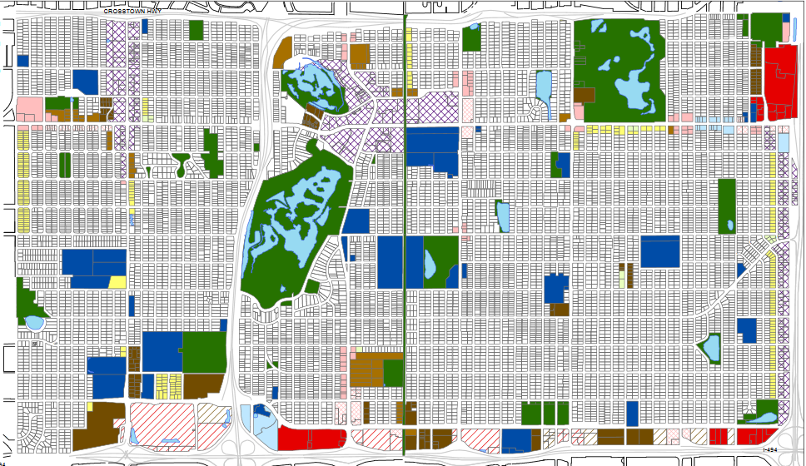
Plan Element Requirements
Recognize 2040 Population, Household and Job Forecasts
Document Existing and Future Land Uses
Document Density Ranges
Plan for Affordable Housing

Slide 7
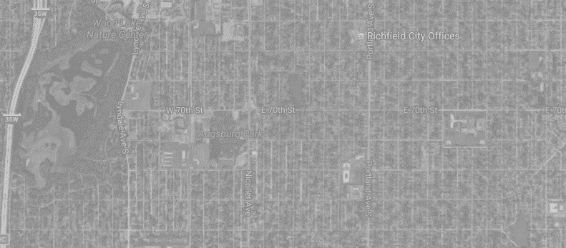
Plan Element Requirements
2008 Forecasts |  |  | Year | Current Forecasts
Population | Households | Jobs |  | Population | Households | Jobs
37,700 | 16,500 | 17,100 | 2010 | 35,228 | 14,818 | 15,604
41,300 | 18,000 | 17,600 | 2020 | 35,700 | 15,600 | 16,600
45,000 | 19,500 | 18,100 | 2030 | 35,600 | 16,000 | 17,100
- | - | - | 2040 | 35,900 | 16,400 | 17,500

Slide 8
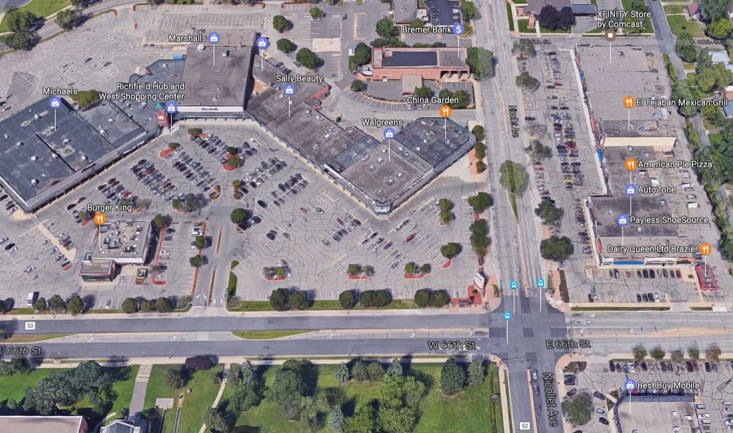
Plan Element Requirements
Economic Competitiveness is Optional
Market Analysis for 66th Street and Nicollet Avenue

Slide 9
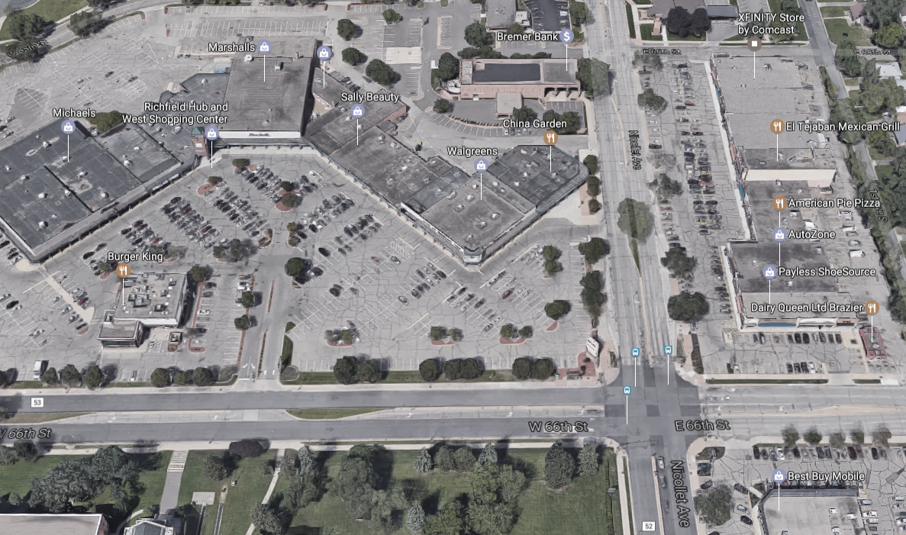
Key Findings
Remain Neighborhood Commercial
More Spending Power/
Higher End Retail
Small Demand for Office Space
Larger Demand for Housing (Multi-Family)

Slide 10
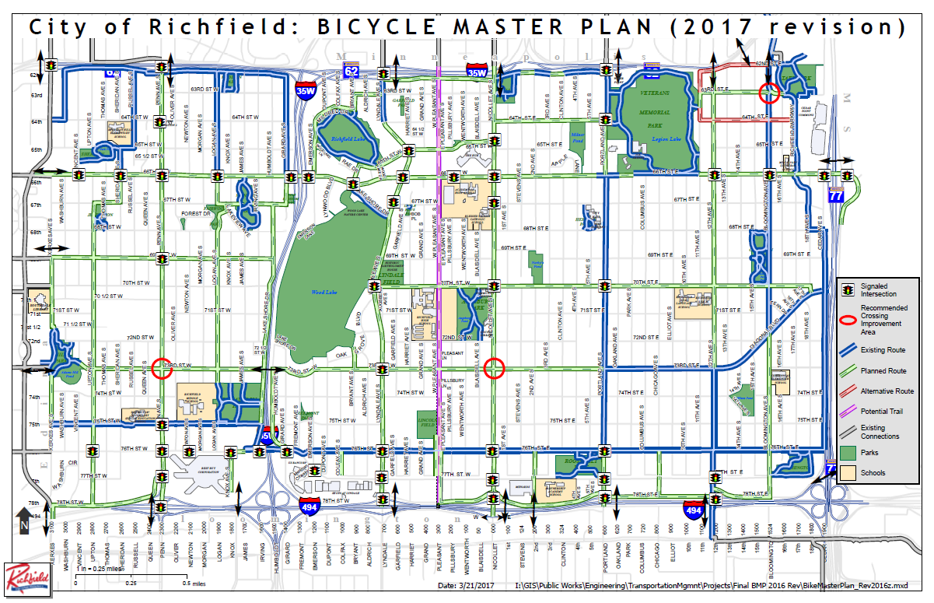
Plan Element Requirements
Sidewalk/Bike Plan
Orange Line
66th Street Improvements
Regional Bicycle Transportation Network (RBTN)

Slide 11
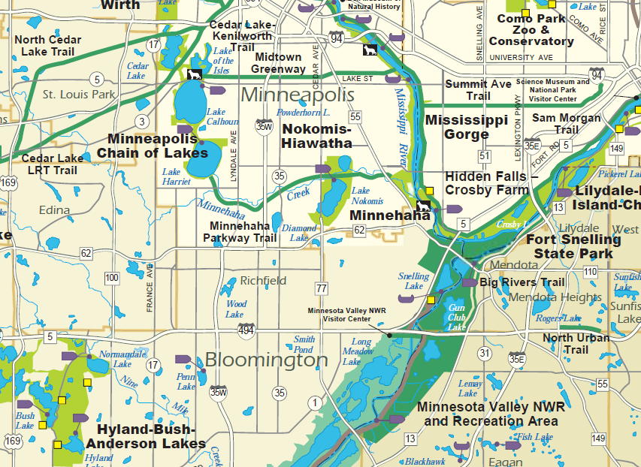
Plan Element Requirements
Recognize the Regional System

Slide 12
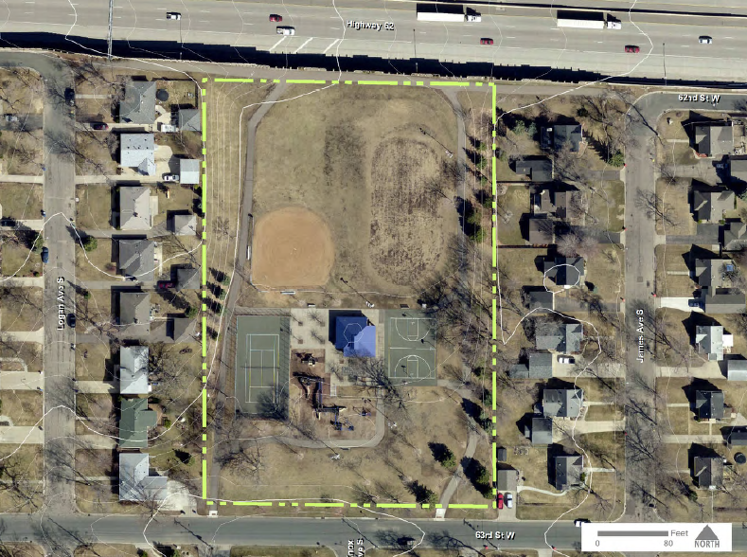
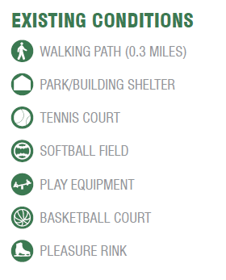
Plan Element Requirements
City Park Master Plan Efforts Underway
Inventory/Evaluation of Park Amenities
Identify Ten Year Priorities

Slide 13
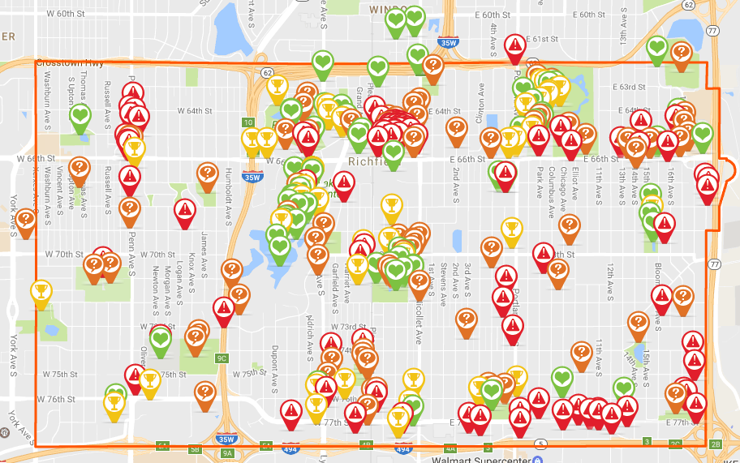
Public Engagement – Online Mapping
900 Unique Visits
Three Weeks
80 – 100+ Respondents

Slide 14
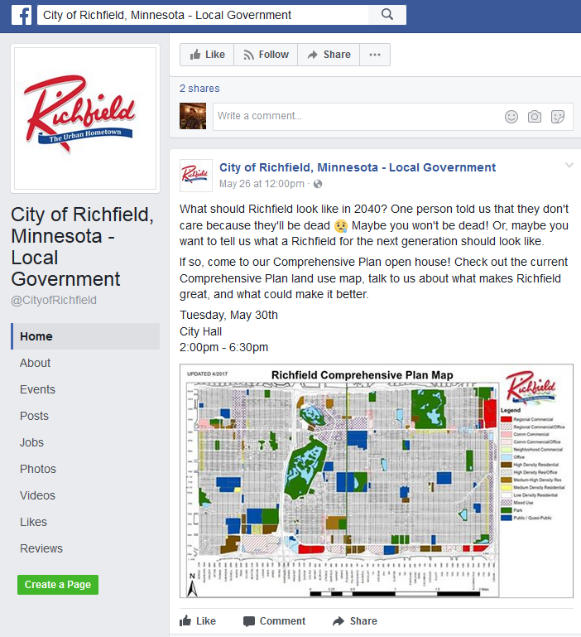
Public Engagement – Social Media
Regular Updates
Staff Responded to Comments

Slide 15
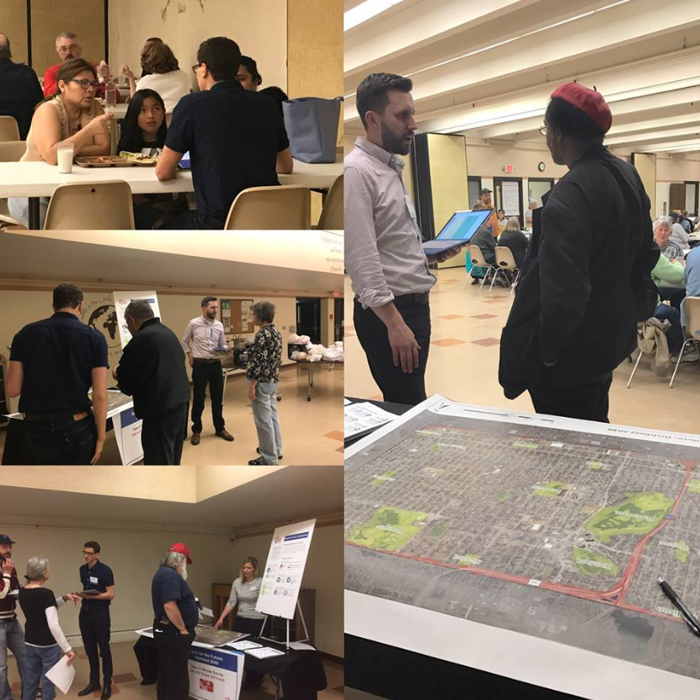
Public Engagement – POP UP EVENTS
City Hall/ DMV
Loaves and Fishes (Hope Church)
Advisory Committee Outreach
Bus Routes

Slide 16
Public Engagement – Key Themes
Urban vs. Suburban
New vs. Old
East Side vs. West Side
Higher Density vs. Lower Density
Affordable Housing Need vs. Too Much Affordable Housing
The Hub: Not Valued vs. Valued (unrepresented populations)

Slide 17
Public Engagement – See Handout
What did you hear?

Slide 18
Group Discussion
How do we embrace and Urban Hometown for all?
What does this look like in 2040?
Land Uses
Housing

Slide 19
Group discussion
Break into Groups
10 Minutes to Review Materials
25 Minutes for Group Discussion
25 Minutes for Reporting Back

Slide 20
Group discussion
Materials in Front of You
2008 Comprehensive Plan Goals and Policies
Public Engagement Findings
2040 Population, Household and Job Forecasts (see Power Point – Slide 7)
2030 Land Use Plan & Density Ranges
Group Worksheet

Slide 21
Group discussion
Ground Rules
Every voice should be heard.
Be respectful of others.
Represent the entire community’s best interest.
Identify someone who will report back.
Notes:
Each Table will have the following materials.
Copies of the Plan’s Goals and Policies
Copy of the Plan’s Land Use Classifications/Densities
Future Land Use Plan (Overlaid with trace paper)
Markers
Group Worksheet

Slide 22
Group Discussion
5 Minutes Remaining….
Notes:
Each Table will have the following materials.
Copies of the Plan’s Goals and Policies
Copy of the Plan’s Land Use Classifications/Densities
Future Land Use Plan (Overlaid with trace paper)
Markers
Group Worksheet

Slide 23
Group Discussion
Report Back….
Notes:
Each Table will have the following materials.
Copies of the Plan’s Goals and Policies
Copy of the Plan’s Land Use Classifications/Densities
Future Land Use Plan (Overlaid with trace paper)
Markers
Group Worksheet

Slide 24
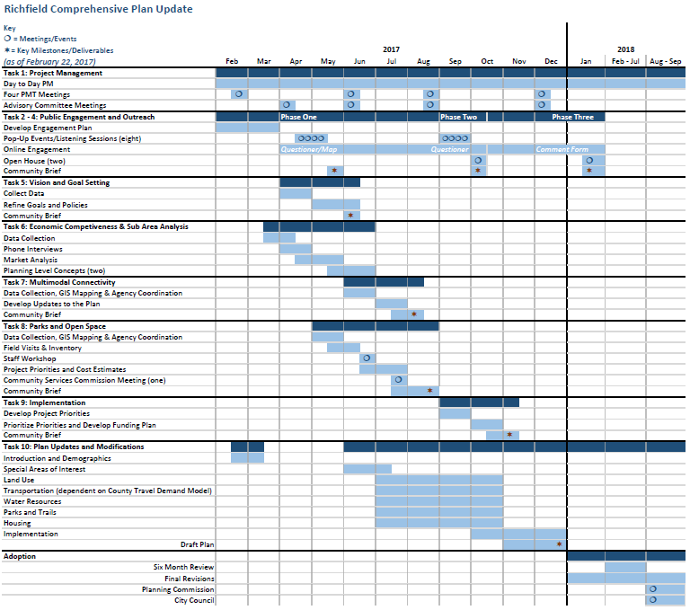
Richfield’s Update
See Handout

Slide 25
Roles & Responsibilities
Meet two more times
Continue o provide guidance and direction
Continue to be champions of the process
Continue to engage others

Slide 26
Questions & Discussions
Advisory Committee Meeting Monday, June 12, 2017

